Slide 1



DA241M PROJECT
Sentiment Analysis
This presentation will introduce our project, Sentiment Analysis of English texts, as part of our Data Science and Artificial Intelligence Minor Course Project.
https://github.com/sray3000/minor-project

Slide 2






DA241M PROJECT
Our Team
PONNEKANTI BIPAN CHANDRA
SOPHOMORE, ECE
230102072
c.ponnekanti@iitg.ac.in
AMANAGANTI CHETHAN REDDY
SOPHOMORE,ECE
230102117
r.amanaganti@iitg.ac.in
SATYAKI RAY
Sophomore, MnC
230123080
r.satyaki@iitg.ac.in
02

Slide 3



DA241M PROJECT
Problem Statement
Using Natural Language Processing(NLP) and ML algorithms for determining the sentiment being conveyed by English texts. This can be very useful while analyzing customer feedback of companies, or movie reviews of audience.
03
https://github.com/sray3000/minor-project

Slide 4

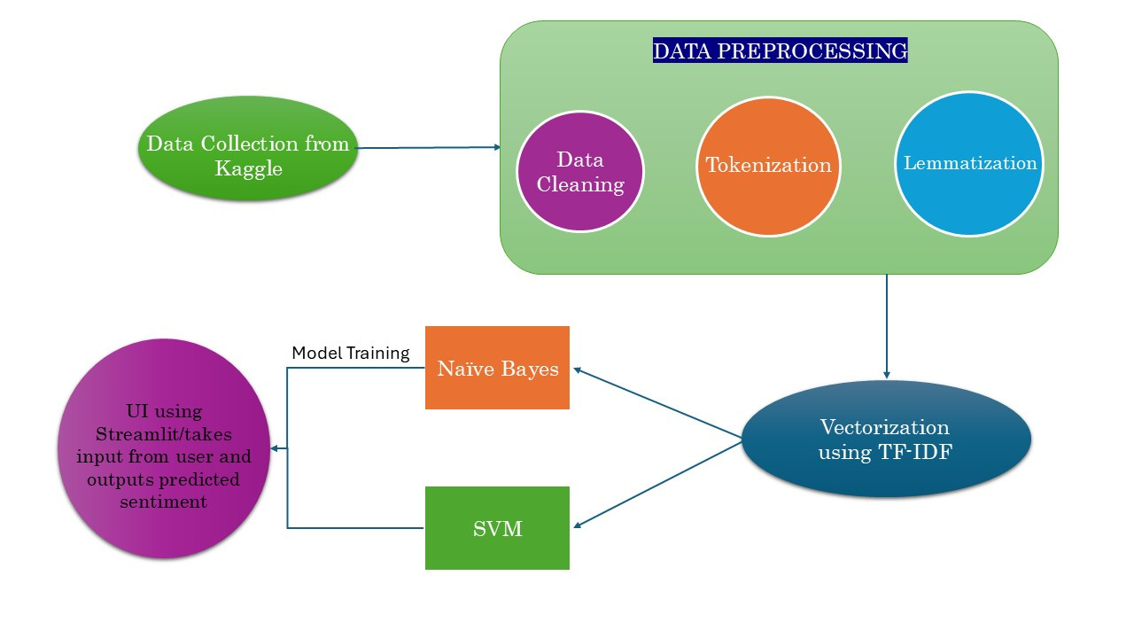
Workflow
04
DA241M PROJECT

Slide 5


05
DA241M PROJECT
Data Collection
We obtained an IMDB movie reviews dataset(CSV file) from Kaggle consisting of 50,000 movie reviews. It was perfectly balanced i.e. consists of equal number of entries of both classes - positive and negative.
Dataset Link

Slide 6







DA241M PROJECT
06
Data Preprocessing
Data Cleaning
Tokenization
Lemmatization
Clean the text reviews by converting to lowercase, fixing contractions, removing HTML tags, URLs and other special characters.
Libraries used: re
Split each review into individual words or tokens and filter out the stopwords.
Libraries used: nltk
Lemmatize(or stem) each token i.e. convert them into their base or root form based on English parts of speech.
Libraries used: nltk

Slide 7
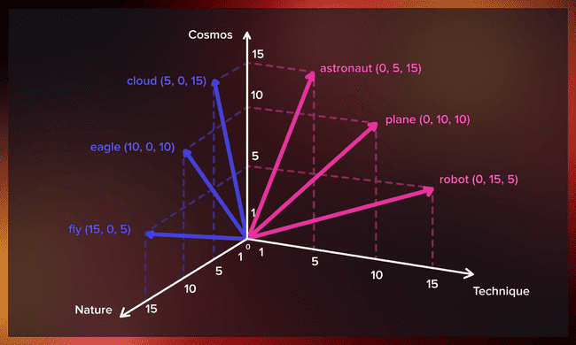
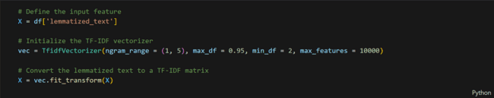
DA241M PROJECT
07
Vectorization
Vectorization is the technique of converting textual data into numeric arrays for ease of computation by machine learning algorithms.
In our project we used the TF-IDF(Term Frequency-Inverse Document Frequency) vectorizer to achieve this.

Slide 8



08
DA241M PROJECT
Model
Development
We designed and implemented two ML models - Naive Bayes and SVM. We created these two models individually and trained and tested them separately.

Slide 9

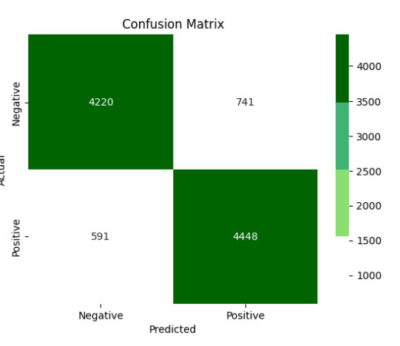
NAIVE BAYES
DA241M PROJECT
Selected for its simplicity and effectiveness in text classification tasks with balanced datasets.
Naive Bayes(Multinomial) works well under the assumption of feature independence, which was particularly effective for this project since the dataset was balanced.

Slide 10

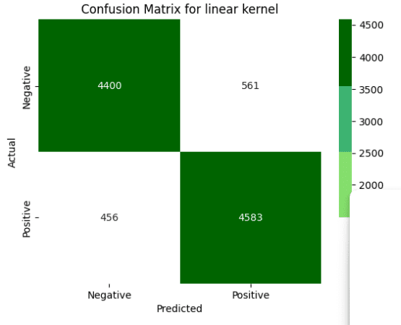
SVM(Linear kernel)
DA241M PROJECT
Used with a linear kernel to find the optimal hyperplane that separates positive and negative reviews.
SVM was chosen for its robustness and higher accuracy in handling balanced data for sentiment analysis.

Slide 11

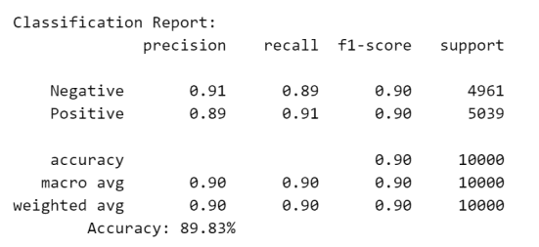
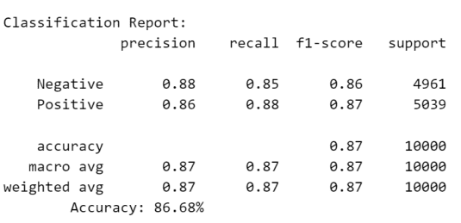
11
Results and
Impact
DA241M PROJECT
SVM showed an accuracy of 89.83% as compared to Naive Bayes’ 86.68%, as well as higher precision, recall and F1 score - indicating higher effectiveness at classifying sentiments accurately within the balanced dataset.
SVM(Linear kernel)
Naive Bayes

Slide 12




Issues
12
DA241M PROJECT
Unbalanced Datasets
Neutral Statements
Complicated Reviews
In unbalanced datasets, our model showed bias towards the class with more reviews.
Since the dataset we selected does not have reviews with neutral sentiment, neutral reviews entered by user can be misclassified.
The reviews that are sarcastic or have complicated English phrases and quotes which often imply opposite meaning, can be classified wrongly.

Slide 13


DA241M PROJECT
Future Directions
We outline future directions for our project by expanding it to various other languages.
Implementing pre-trained models like BERT will improve the handling of complex language features such as idioms, sarcasm, and context-dependent sentiment that simpler models like Naive Bayes and SVM may miss.
13

Slide 14

DA241M PROJECT
We would like to express our sincere heartfelt gratitude to our course instructor, Dr. Teena Sharma for her constant guidance, feedback, and support throughout this entire project, and for giving us this grand opportunity to present our project.
Thank You!

